Slide 1


Slide 2
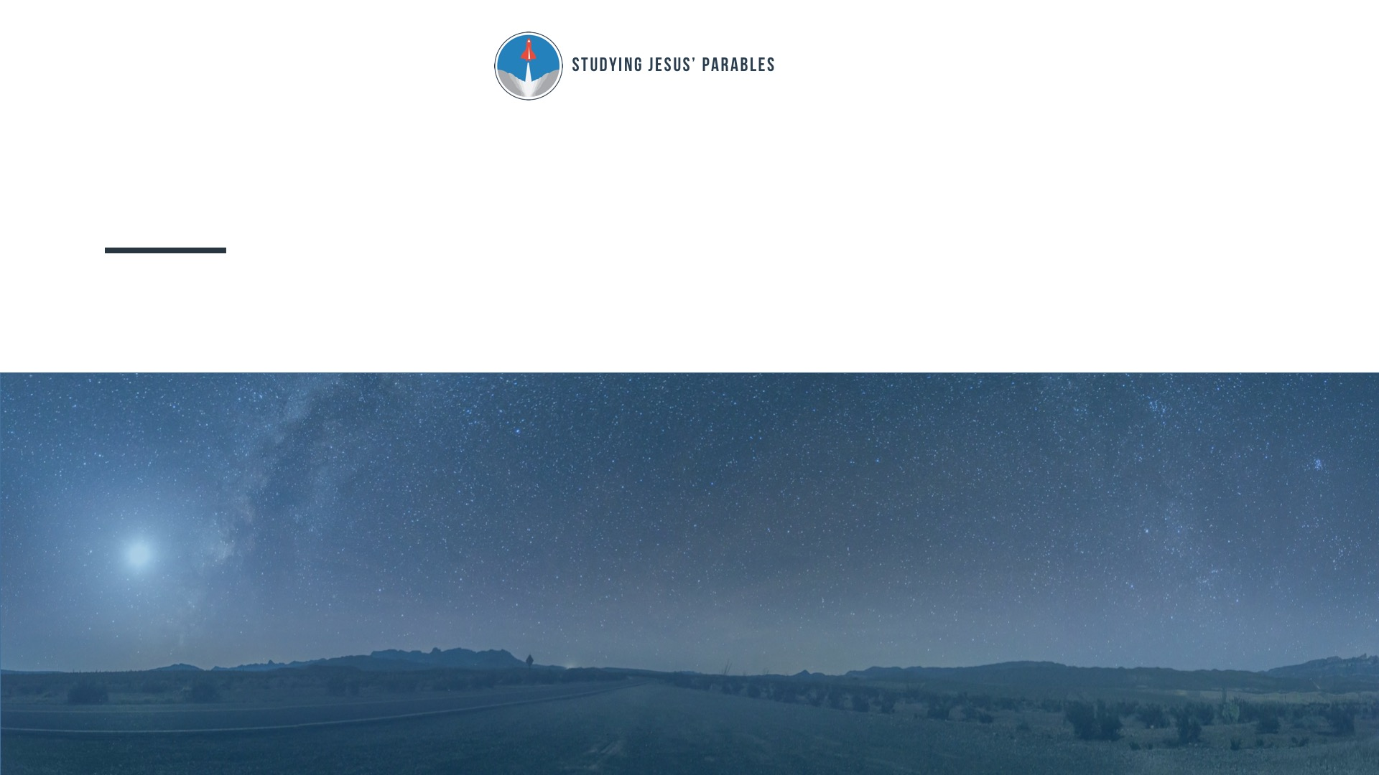
Lesson 3: THE PARABLE OF THE UNMERCIFUL SERVANT
Matthew 18:21-35

Slide 3

If we confess our sins, he is faithful and just to forgive us our sins and to cleanse us from all unrighteousness.
1 John 1:9

Slide 4

Do you find it easier to ask for forgiveness or to extend forgiveness to others? Explain.

Slide 5
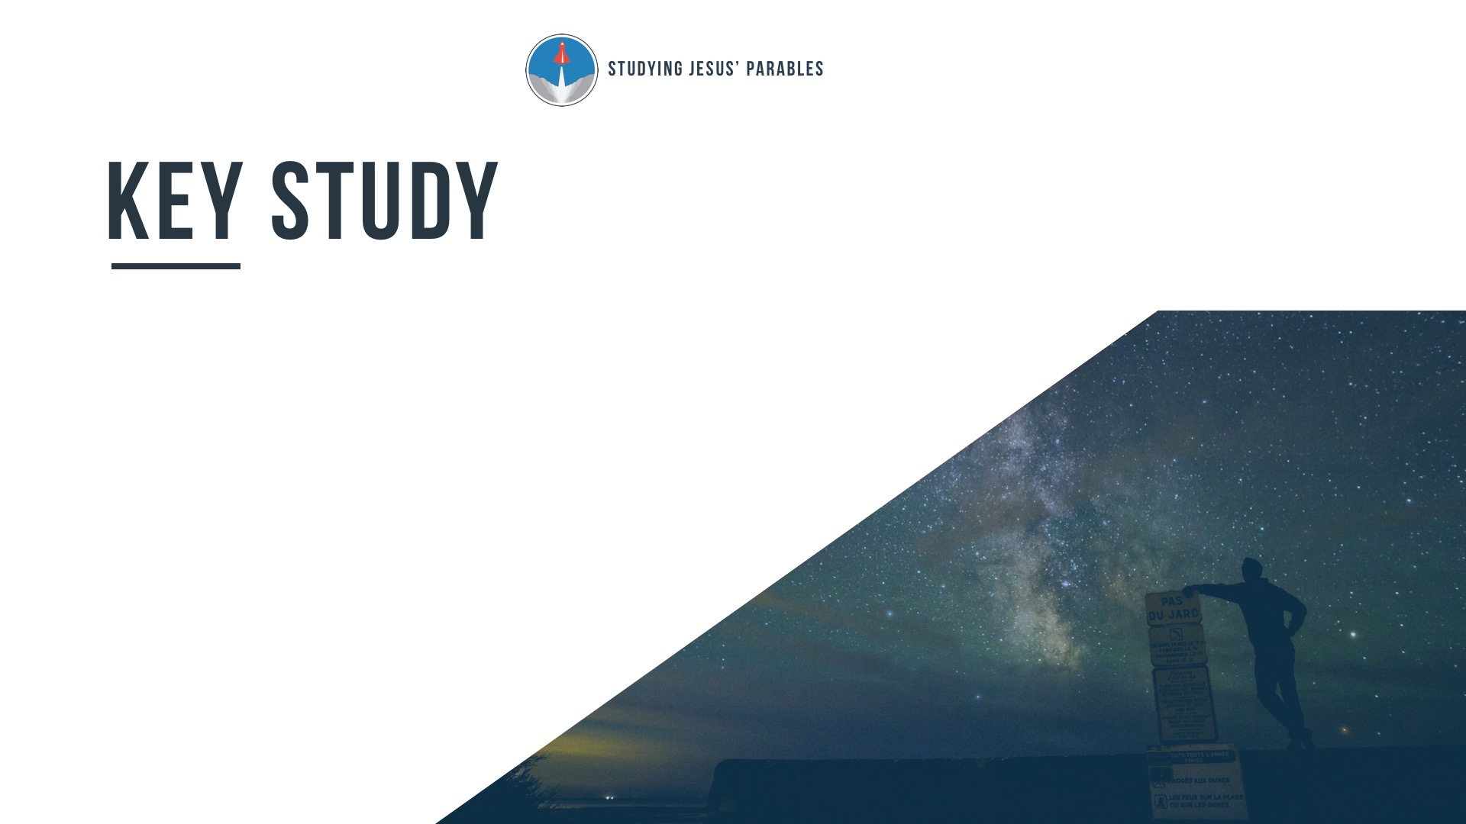
Believers are expected to generously forgive people who sin against them (Matthew 18:21-22).

Slide 6
Believers have received extravagant and unmerited forgiveness from God
(Matthew 18:23-27).

Slide 7
Believers who refuse to forgive others will not receive God’s forgiveness (Matthew 18:28-35).

Slide 8

Why is it hard to forgive someone for a single offense? Why is it even harder to forgive someone for repeated offenses?

Slide 9
How have you felt when someone honored your request for forgiveness? How have you felt when your request for forgiveness was rejected?

Slide 10
Is there anyone in your life whom you need to forgive? What’s keeping you from forgiving them?

Slide 11
What are some physical, emotional, and spiritual consequences for refusing to forgive others?

