Slide 1


Slide 2

HIS IDENTITY IN SCRIPTURE
John 1:1–5, 1:14, 5:31–47

Slide 3
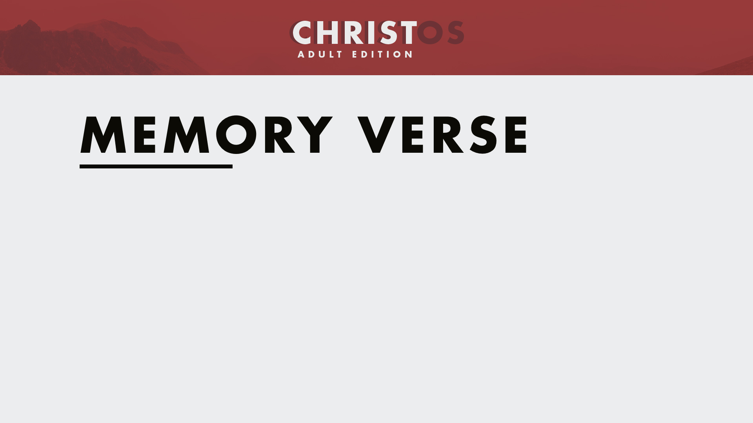
“The Word became flesh and made his dwelling among us. We have seen his glory, the glory of the one and only Son, who came from the Father, full of grace and truth.”
John 1:14

Slide 4

What strengthens the credibility of the testimony of a witness?

Slide 5
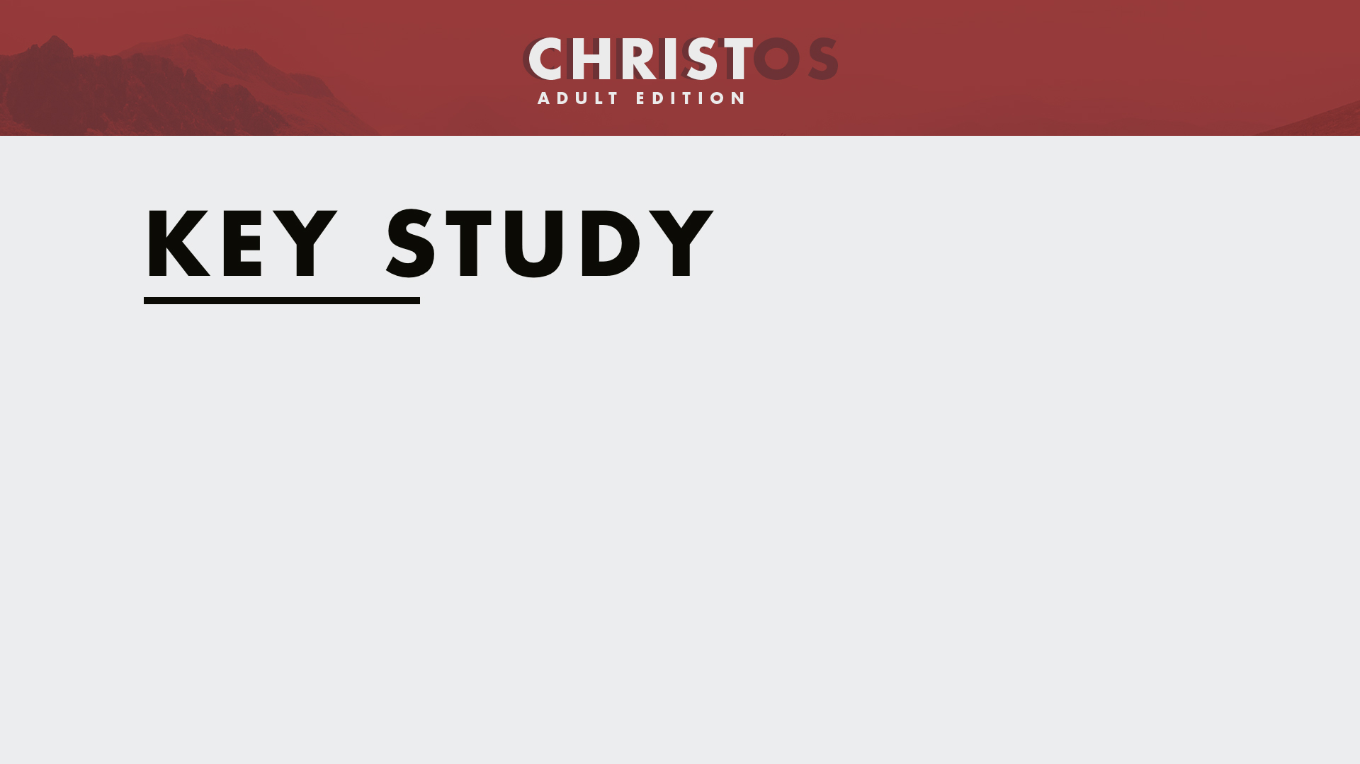
We can trust our lives to Jesus because He is God, Creator, and Savior (John 1:1–5, 1:14).

Slide 6
We can trust our lives to Jesus based on the credible testimony of others (John 5:31–47).

Slide 7

John described Jesus as “the Word,” “Creator,” “Life,” and “Light.” How do these titles for Jesus shape your view of who Jesus is?

Slide 8
Why is Jesus’ incarnation—becoming a man and living among us—important to our faith?

Slide 9
In what ways has accepting Jesus as Messiah brought truth, life, and light into your life?

Slide 10
How can believers offer their witness to Jesus’ identity as they encounter people every day?

