Slide 1
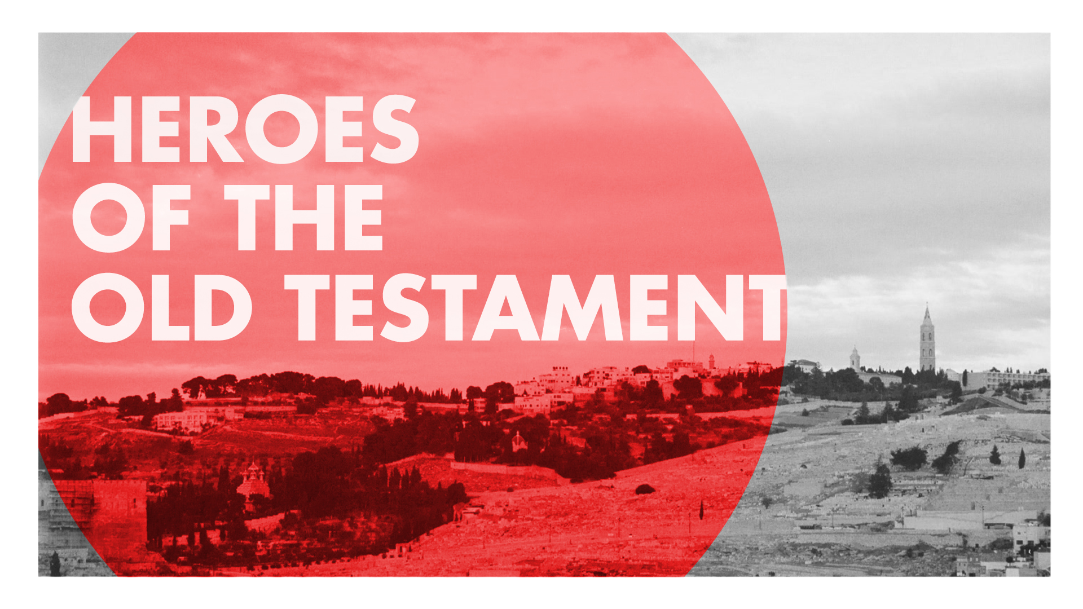

Slide 2

Lesson 1
CALEB THE SPY
Numbers 14:20-38

Slide 3
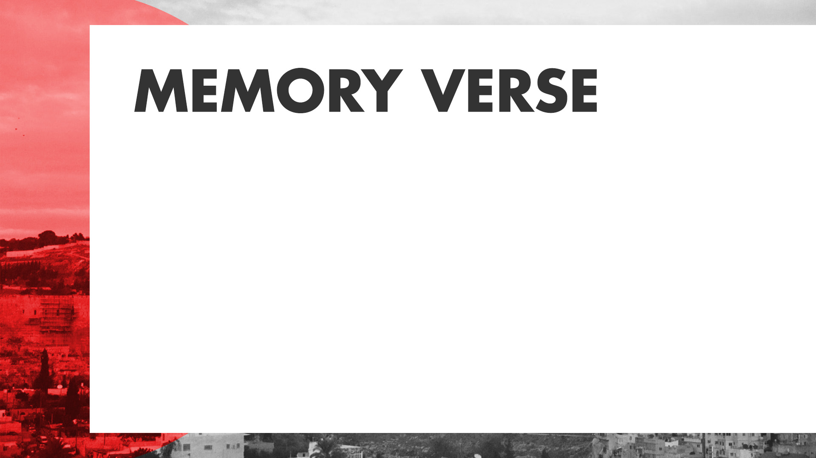
But my servant Caleb, because he has a different spirit and has followed me fully, I will bring into the land into which he went, and his descendants will possess it.
Numbers 14:24

Slide 4
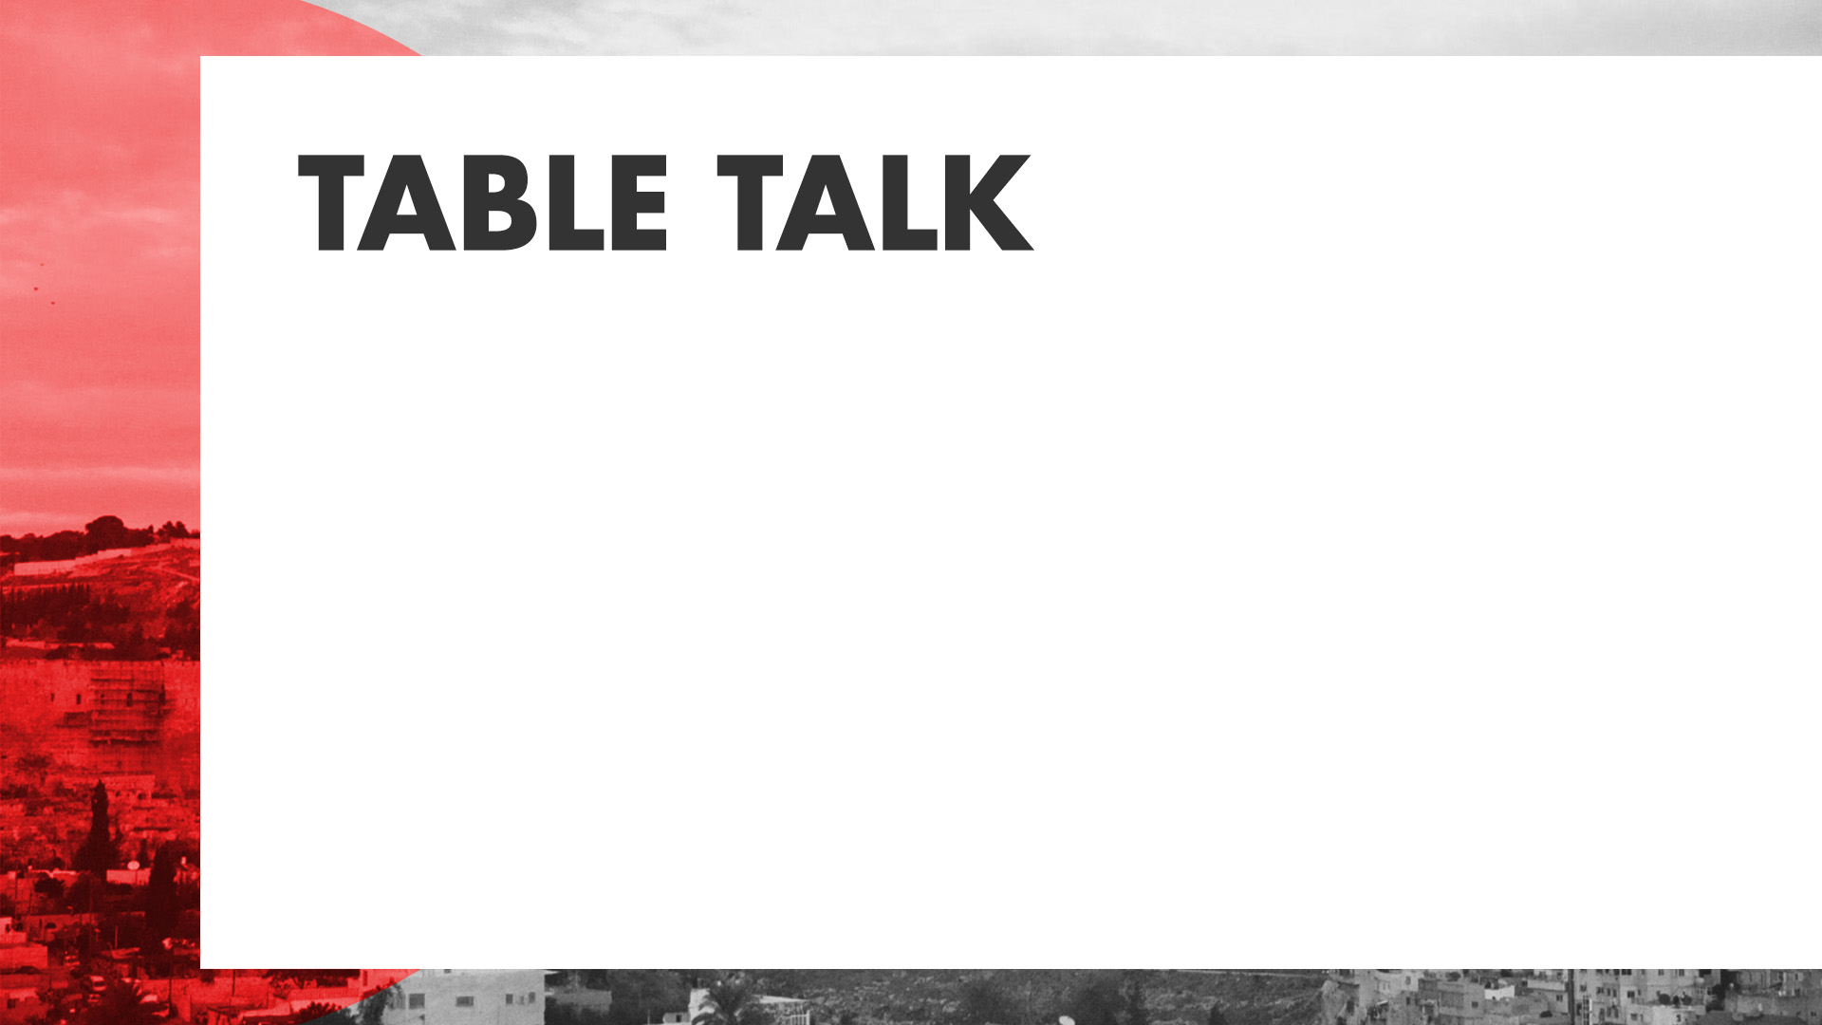
Why is it important to be faithful to God when other believers do not agree?

Slide 5
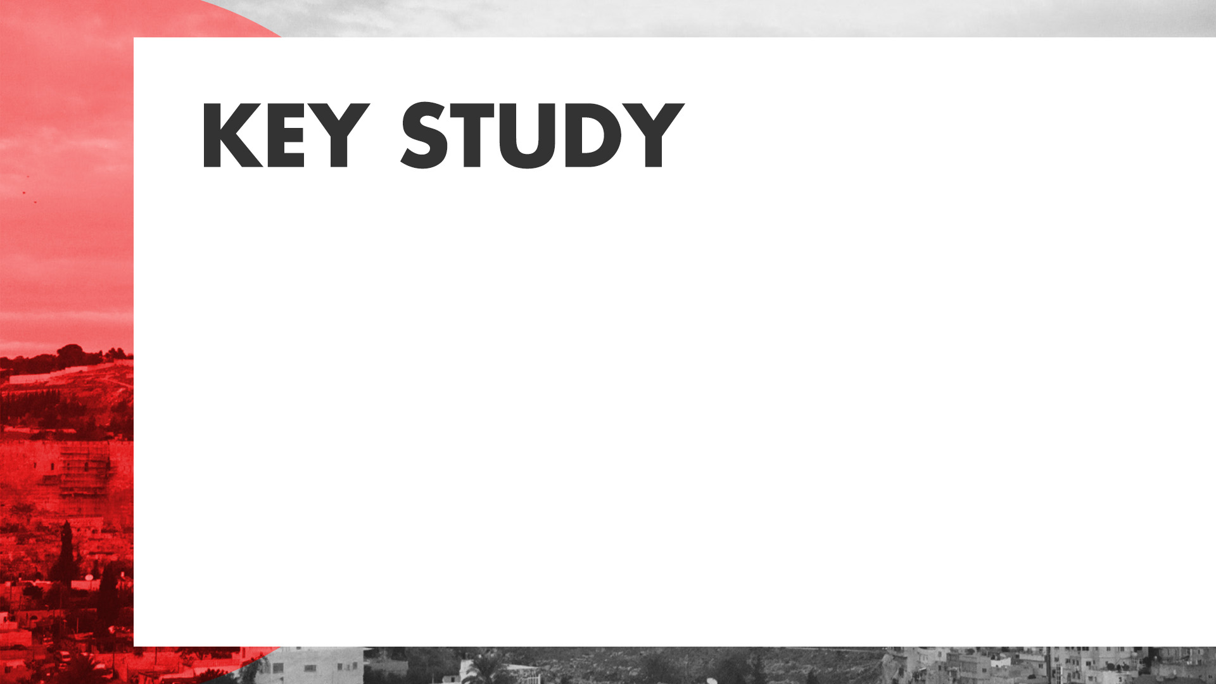
When we refuse to obey God, He disciplines us (Numbers 14:20-23).

Slide 6
When we choose to obey God, He rewards us (Numbers 14:24).

Slide 7
When we disobey God, He allows us to suffer the consequences (Numbers 14:25-38).

Slide 8

Caleb had to wait 40 years to enter the Promised Land even though he obeyed God and remained faithful. What does that tell you about the nature of community?

Slide 9
How could Caleb remain so faithful in the face of so much opposition?

Slide 10
What does a life of wholehearted commitment to God look like?

Slide 11
Consider a time when the spirit of those around you did not honor God. What would it look like for you to have a “different spirit” like Caleb?

