Slide 1


Slide 2
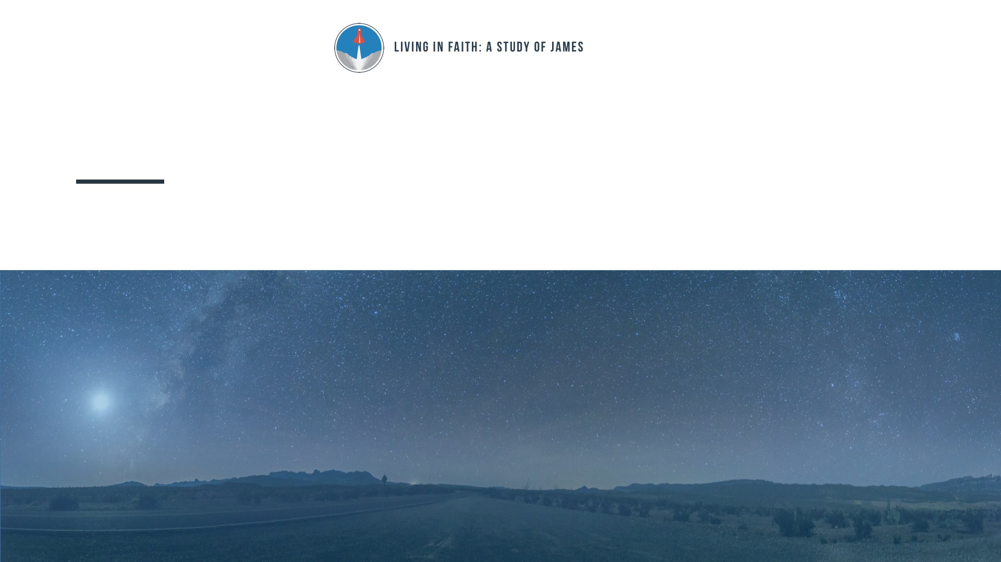
Lesson 38: Growing Faith
James 1:2-4, 12-17

Slide 3
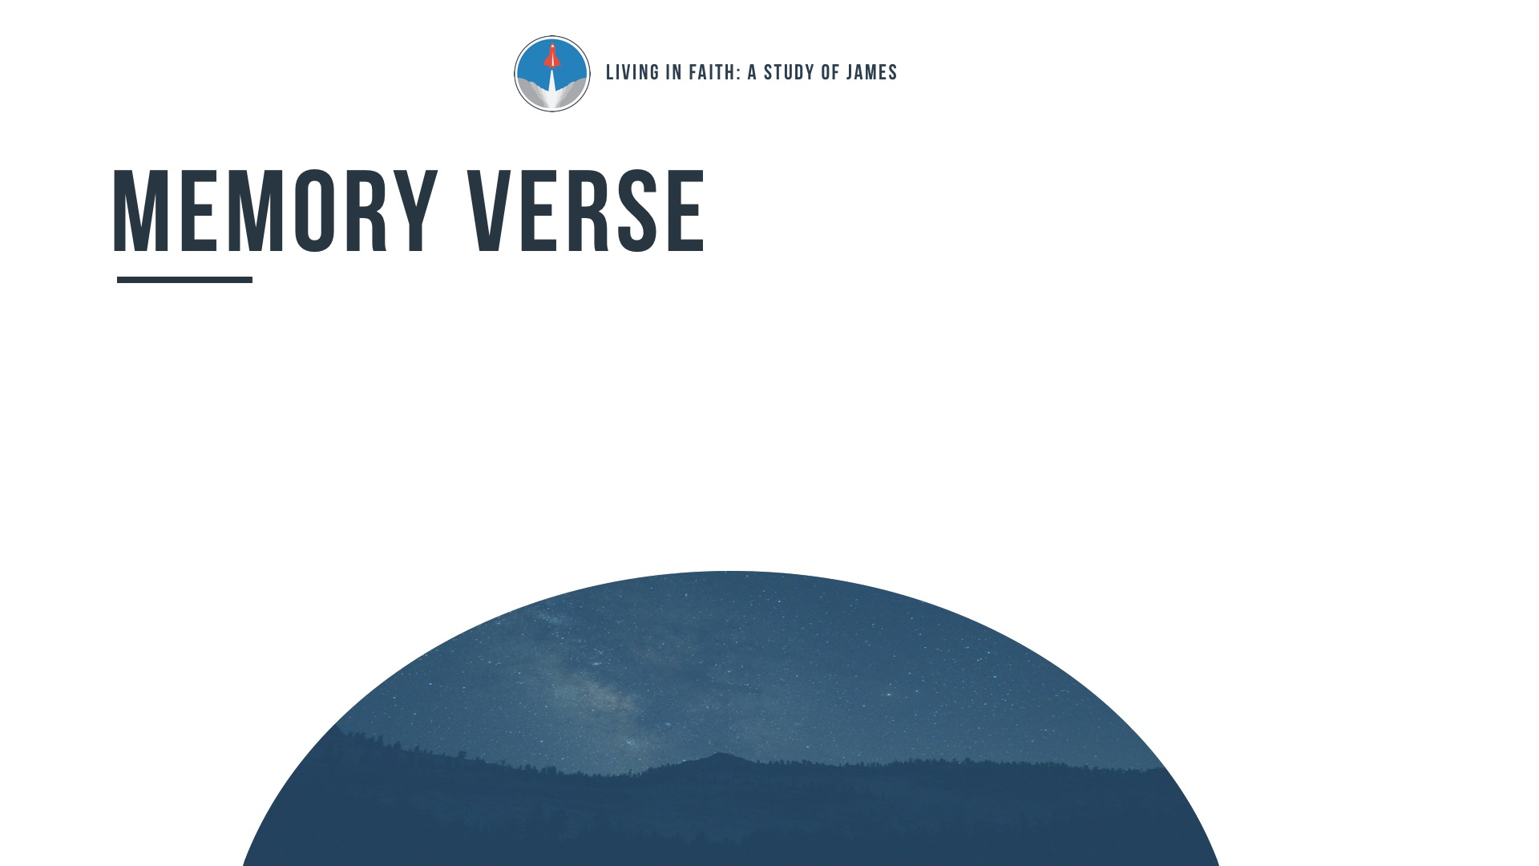
“Blessed is the man who remains steadfast under trial, for when he has stood the test he will receive the crown of life, which God has promised to those who love him.”
James 1:12

Slide 4

Why does God allow believers to experience hardship and suffering?

Slide 5
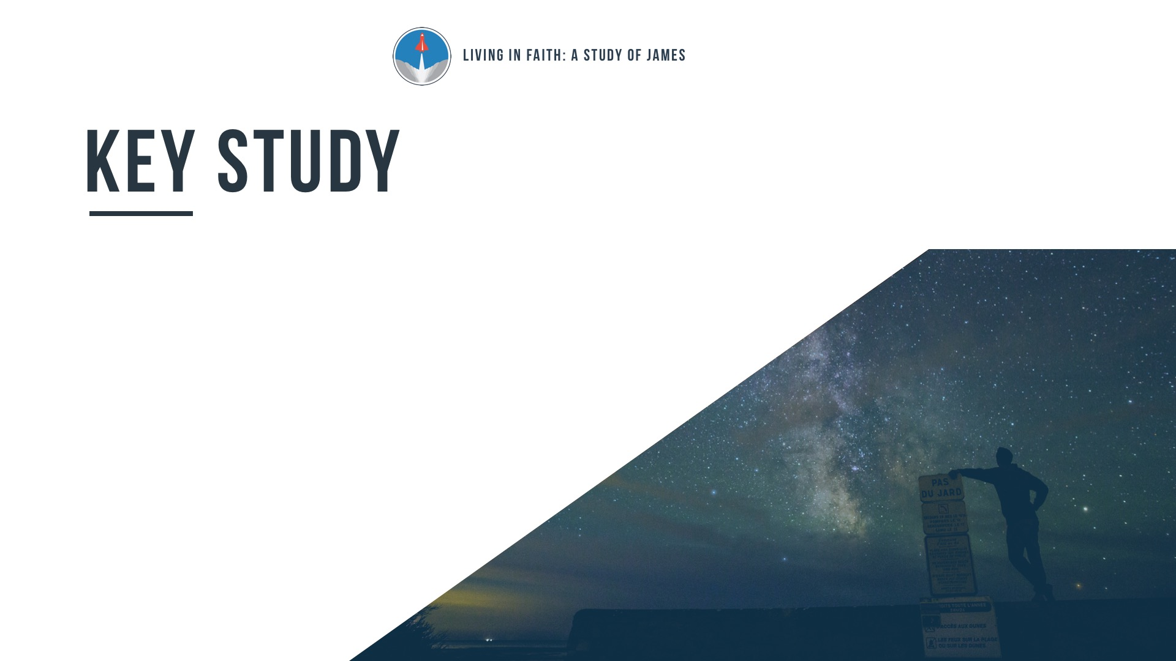
Trials test the sincerity of our
faith and build perseverance
(James 1:2-4, 12).

Slide 6
God allows trials to mature our faith, but never tempts us to do evil
(James 1:13-15).

Slide 7
God remains good even in
The midst of our difficulties
(James 1:16-17).

Slide 8
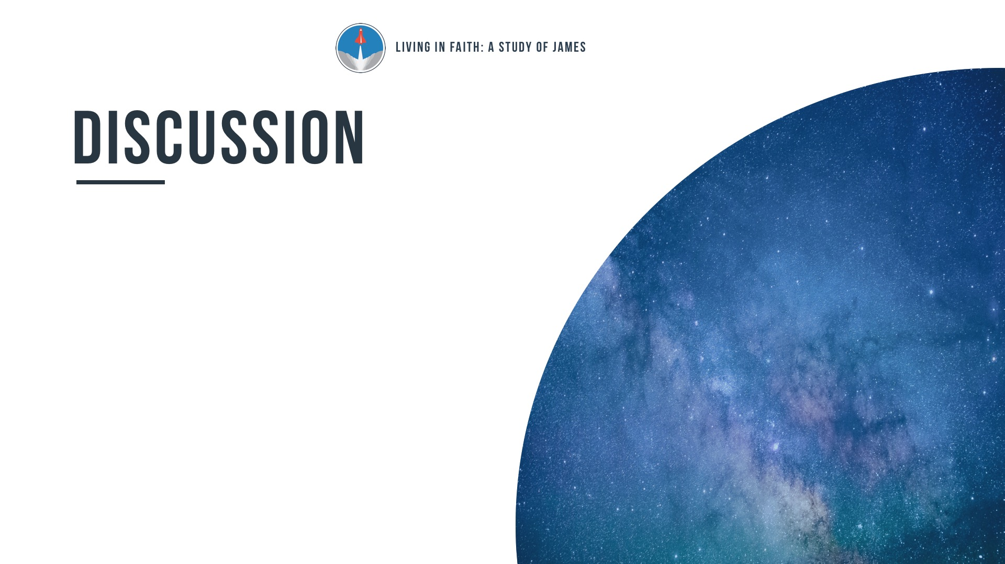
Given the chance to go through a trial or avoid it,
what would you do and why?

Slide 9
What have you learned about God and yourself through the trials you have faced?

Slide 10
What are some ways to protect yourself against the many sources of temptation that you face each day?

Slide 11
If every good thing comes
from God, then why does
God allow us to experience difficult times?

