Slide 1


Slide 2

HE IS NOT HERE
Luke 24:1-12,36-49

Slide 3
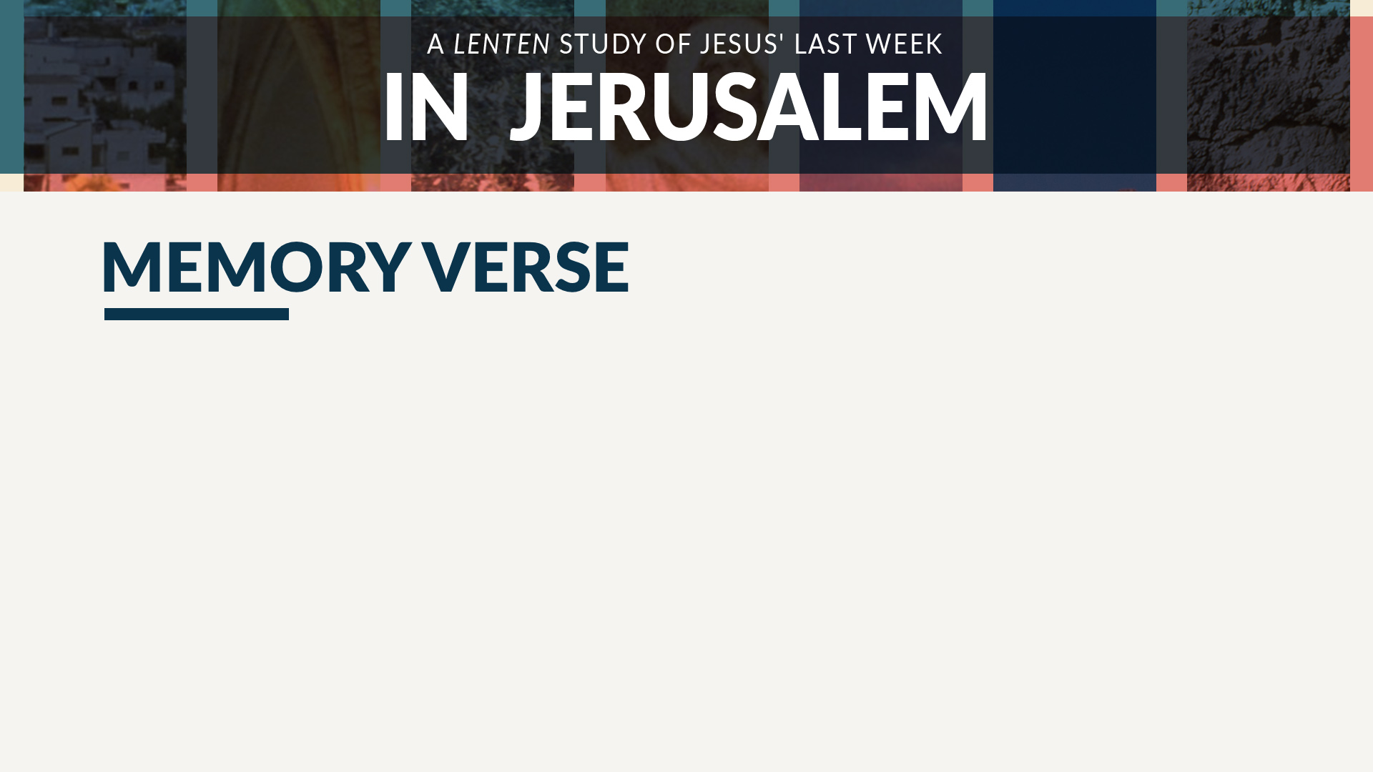
“Why do you seek the living among the dead? He is not here, but has risen.”
Luke 24:5b-6a

Slide 4

How different would our story be if Jesus had been found dead in His tomb?

Slide 5
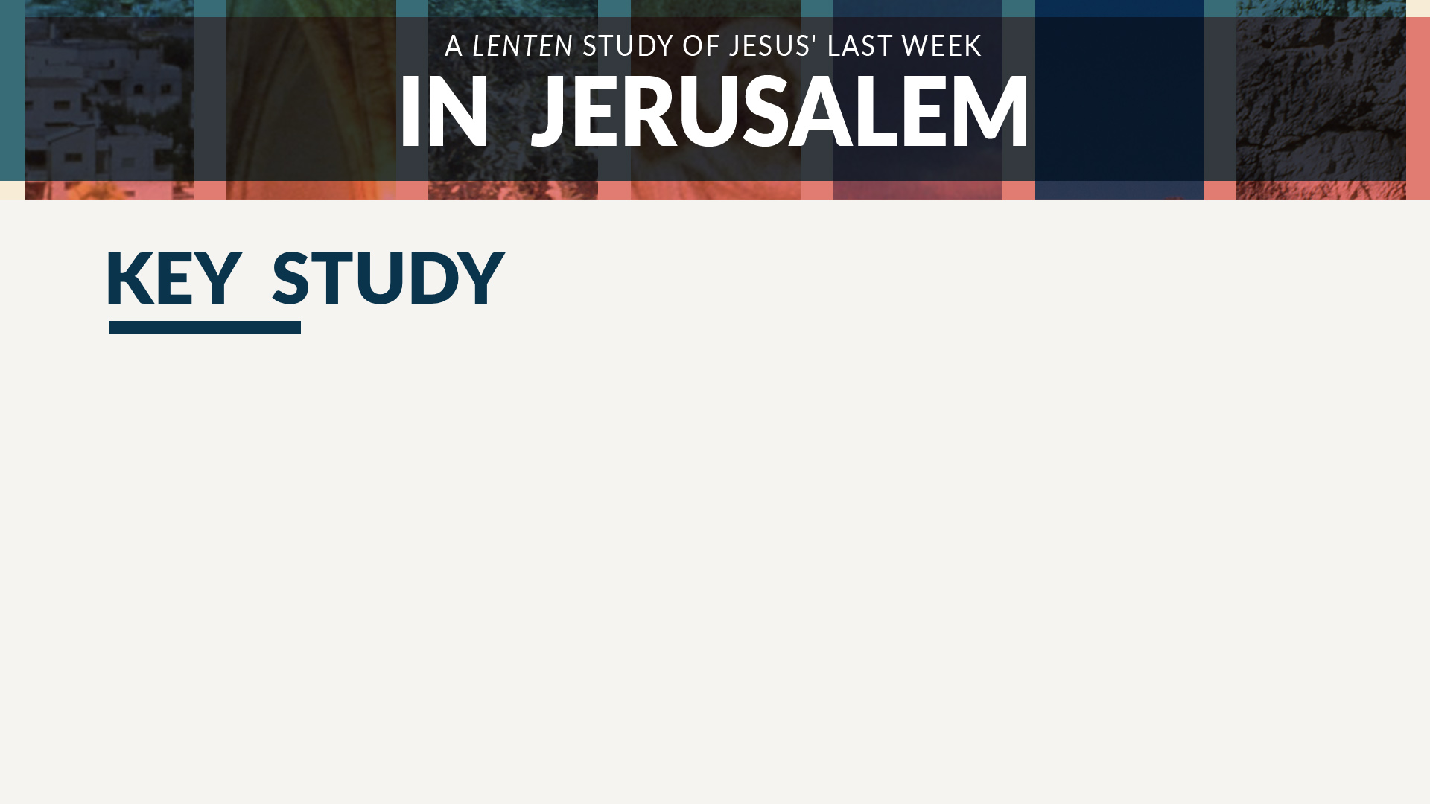
Because Jesus was alive, His tomb was empty (Luke 24:1-12).

Slide 6
Because Jesus was not in the tomb,
He appeared before His disciples
(Luke 24:36-43).

Slide 7
Because Jesus was about to ascend into heaven, He explained what was to come (Luke 24:44-49).

Slide 8

What feelings would the women have approached the tomb with?

Slide 9
How did the disciples’ reaction to the news of the empty tomb show disbelief?

Slide 10
How did Jesus’ appearance to His disciples demonstrate both His divinity and His humanity?

Slide 11
What would your life be like today without Jesus’ death and resurrection?

